Slide 1

Week 1

Slide 2
Steps to solve a problem with Java
Initialize objects, because Java is an OOP(object-oriented programming) language
Define each object’s characteristics (variables) and behaviour (functions/methods)
Re-use previously created objects without writing new code
Extend an existing object to create a new but similar object (Inheritance)

Slide 3
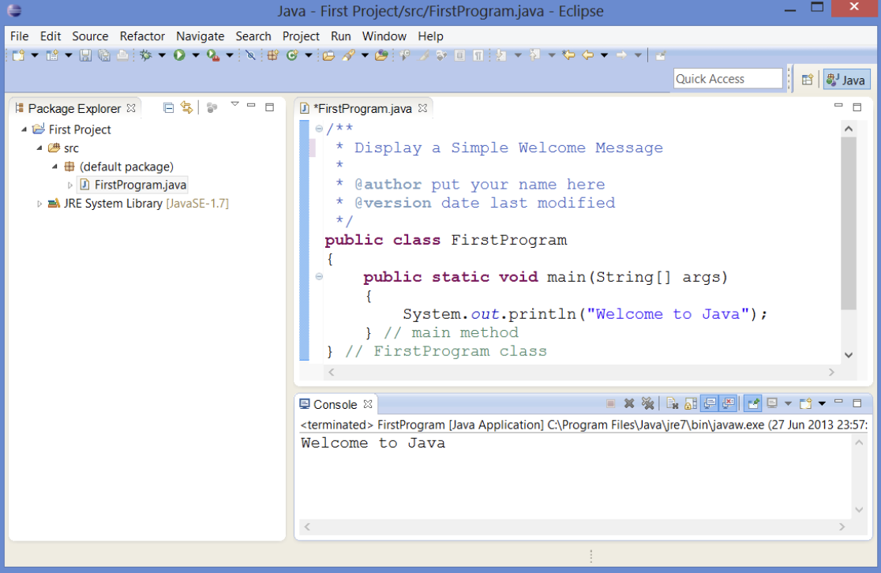
First Program

Slide 4
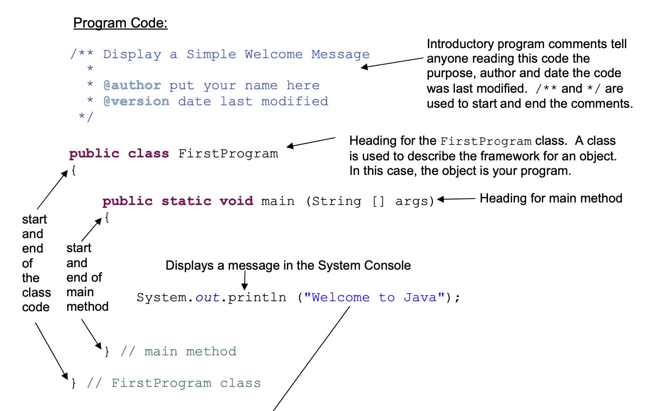

Slide 5
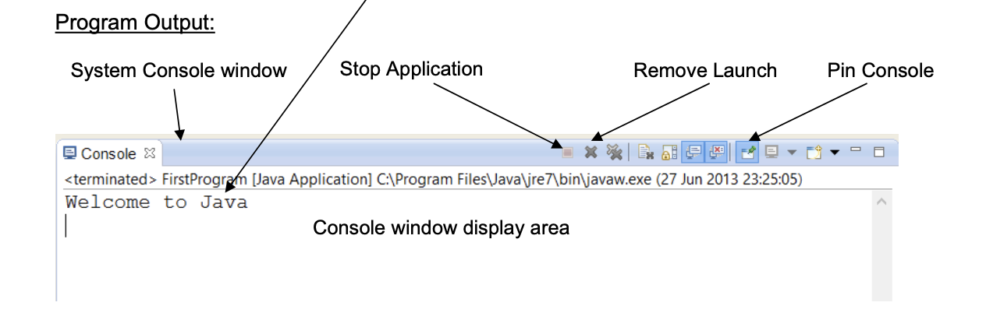

Slide 6

An object is an instance of a class
Every program needs at least ONE class
Can only have ONE public class in a source file, but any number of non-public classes
Class name always begins in capital letter, the rest of the name should be camel case (true for variable names)

Slide 7
Every program class needs a main method, tells the computer where to start
Every main program starts with the same heading

Slide 8
`println` is short for print line
“Welcome to Java” is a parameter to the println method, it is a String parameter because it is enclosed in double quotes

Slide 9
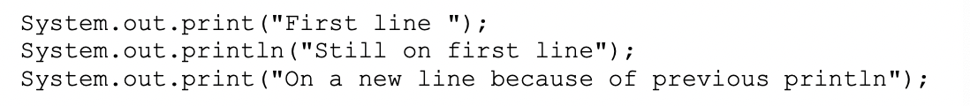
Differentiate between print and println
Try the following code…

Slide 10
Semicolon (;)
Placed at the end of each Java statement
Class and method headings do not end with ;

Slide 11
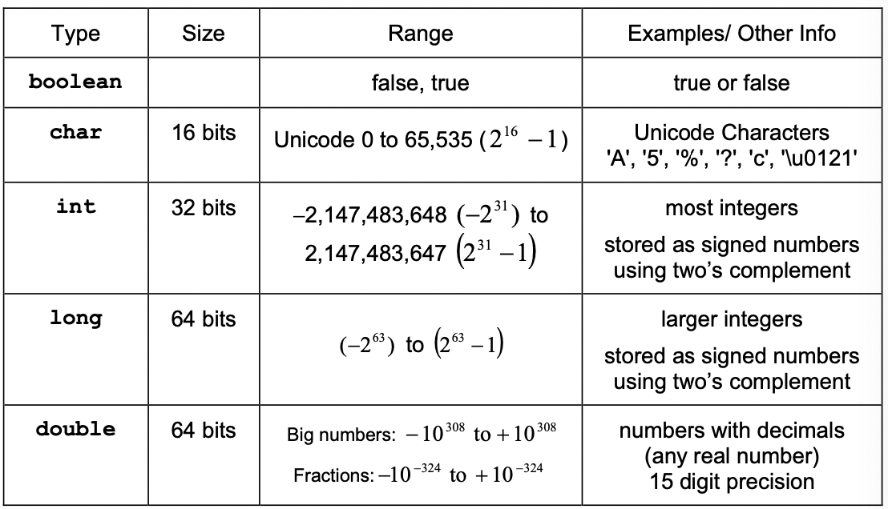
Variables and Primitive Types

Slide 12
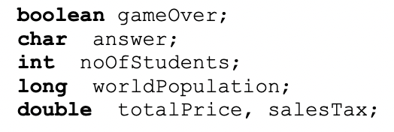
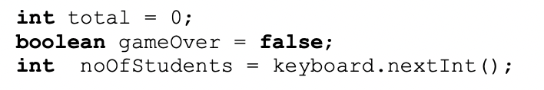
Declaring variables
Give the variable a type and a name…

Slide 13

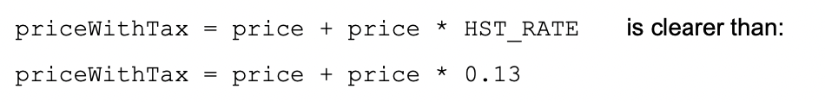
Constant Variable - final

Slide 14
String
- Is an object, NOT a primitive type

Slide 15

Scanner (Java Class)
- Tells compiler to look for the Scanner class code in the java.util package
Notes:
Page 1-17

